Slide 1

ATP Results 2013-2023
Spencer Skidmore

Slide 2
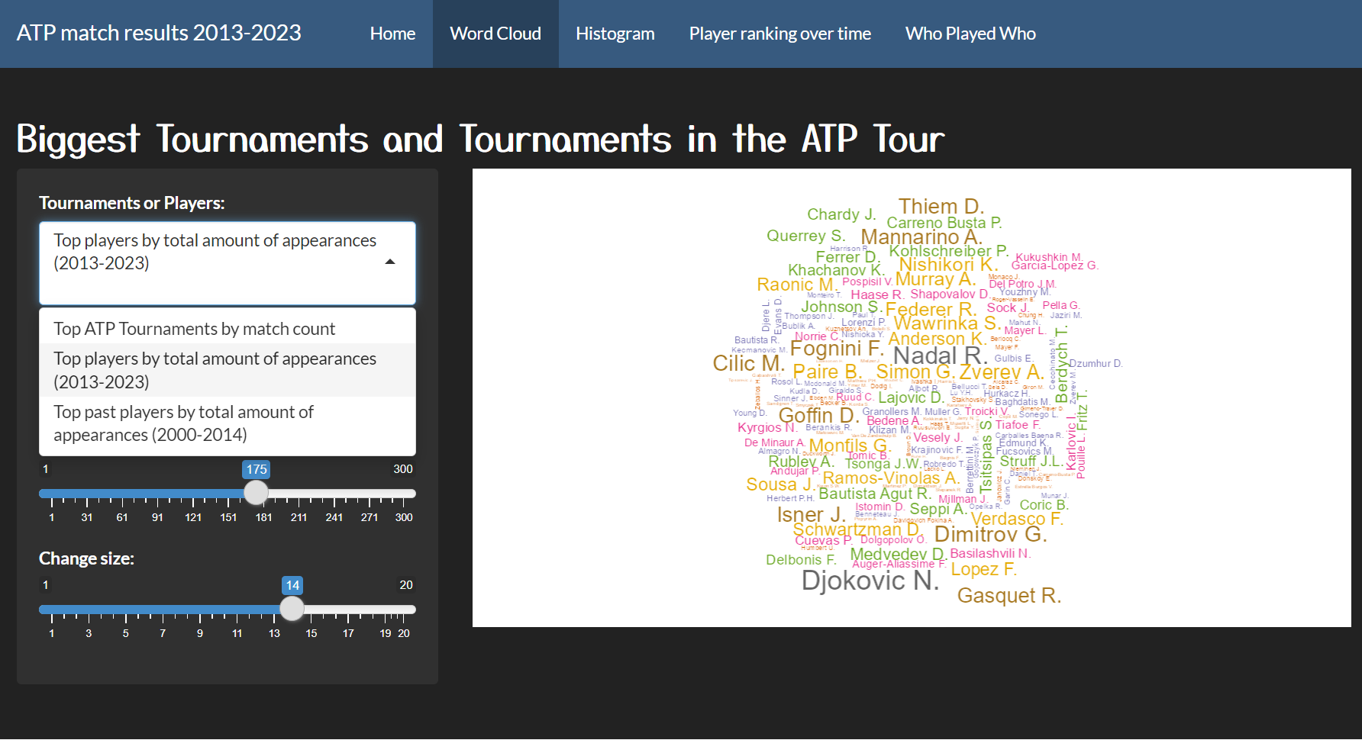
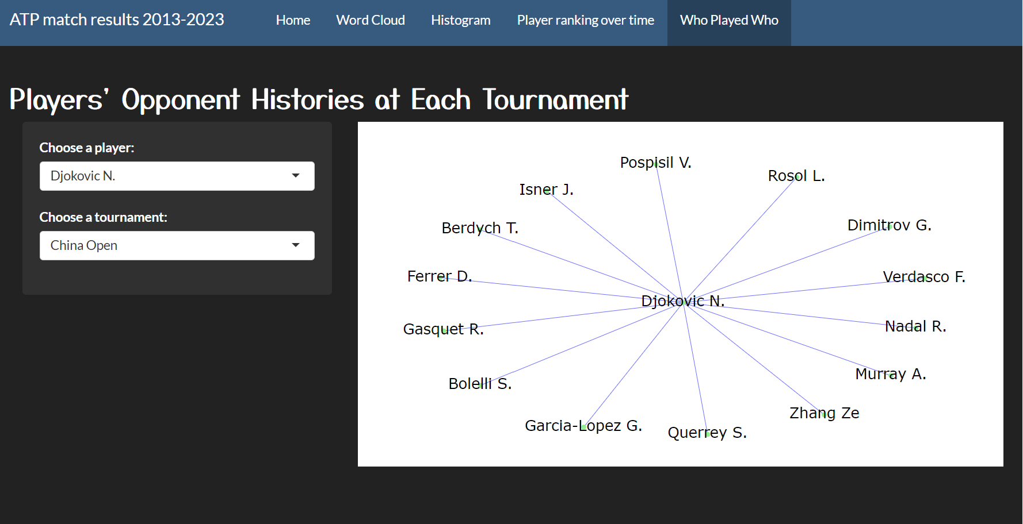
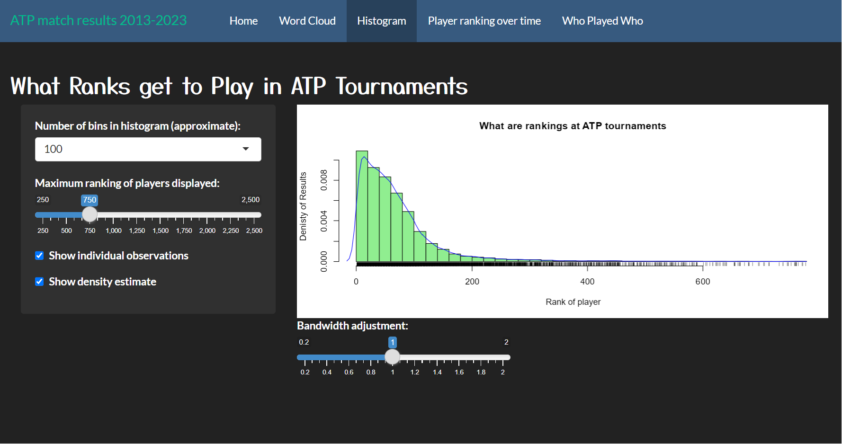
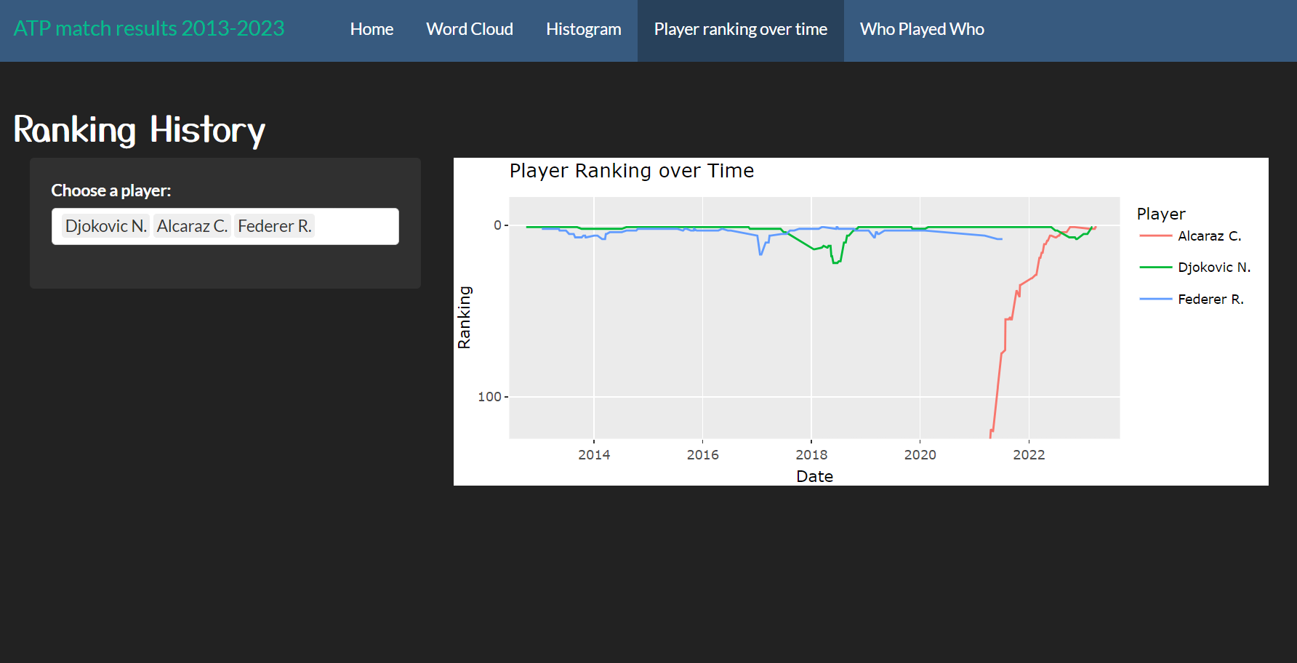
Project Purpose
Glean information from The Association of Tennis Professionals’ results over the last 10 years.
Enjoyment
Teaching

Slide 3
Project Questions
Who played the most.
Word Cloud
Biggest tournaments.
Word Cloud
Ranking Cut off.
Histogram
How have rankings changed.
Player Ranking over Time
Opponents at different tournaments.
Who Played Who (network graph)

Slide 4
Project Insights
Word Cloud
more prolific such as Grigor D.
Djokovic N. outshined by Ferrer from 2000-2014
Histogram I
drop off after the top 20 hardly any lower than 300
Player ranking over time
drop in ranking due to injury
Djokovic, Nadal, Federer, and Alcaraz compare over time
Network
Federer and Djokovic have never played at the China Open before.

